Slide 1
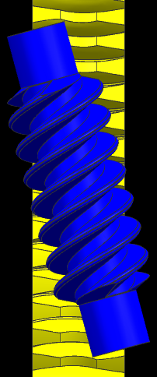
CCM-85: Skewed Worm Axis for SPEPS – 15° Intersect Angle
Last updated: 23FE16
Description
Develop and characterize a 15° skewed worm gear set
Motivation : XX
Deliverables
Assist mech durability
Acceptable NVH performance
Backdrive performance
Efficiency
Timing
Assist mech durability – Ongoing
Running parts with conditioning cycles
Running parts with varying run-in cycles (changing load and speed)
Team Members/Customers
Team names: Jeff Beyerlien / Adam Lee
Customers:

Slide 2
CCM-85: Skewed Worm Axis for SPEPS – 15° Intersect Angle
Last updated: 23FE16
Status Update:
AM bottoming tests ongoing
At current load of 74Nm, durability is not a concern
Parts have develop lash/low backdrive very early
Zoning
High FLV/TPV at backdrive speeds of 30RPM.
Problem does not exist at 5RPM
Removing/uncompressing isolators improves the backdrive plot.
Challenges:
Assist mech stand availability
Poor AM bottoming performance
Part/vehicle availability for NVH
Next Actions:
NVH
Need to do a rattle study in vehicle to determine acceptable level of backdrive after 1 life.
Put high FLV/TPV parts in car to determine acceptable level

